Slide 1

Automated Text Summarization for News Articles
“In an age of overwhelming information, text summarization helps extract key insights efficiently.”
Presenter: MN. SIHANAS
Supervisor: MRS. ALF. SAJEETHA

Slide 2
Table of contents
Background Information
Introduction
Project Objectives
Methodologies
Dataset
Model Evaluation & Selection
Top Level Architecture
Timeline
Demonstration
Challenges
Lessons Learned
Future Direction
Conclusion

Slide 3
01. Background Information
About the Project:
In an era of overwhelming digital content, news articles are published in vast quantities every day.
Manually reading and extracting key information from these articles is time-consuming and inefficient.
Automated text summarization offers a solution by generating concise summaries that retain the essential information.
Importance:
Helps readers save time by focusing on the core information in news articles.
Promotes accessibility for users with limited time or specific interests.
Enables quick decision-making and knowledge acquisition in various domains like journalism, education and research.

Slide 4

02. Introduction
News text summarization is the process of automatically generating a concise and meaningful summary of news articles.
It involves extracting or abstracting key information from lengthy articles while maintaining the context and intent.
By automating summarization, the project addresses the challenges of processing the overwhelming influx of digital news content.

Slide 5
03. Project Objectives
Develop an Efficient Summarization Tool: Create a system capable of summarizing news articles from URLs into concise, meaningful summaries.
Optimize Time and Effort in News Consumption: Enable users to quickly extract the key information from lengthy news articles, improving productivity and comprehension.
Demonstrate NLP Capabilities: Showcase the application of advanced Natural Language Processing techniques in real-world scenarios.

Slide 6
04. Methodologies
Methodology | Description
Model Selection and Evaluation | Evaluated T5-base and Bart-base models for abstractive summarization. Chose T5-base due to a higher F1 score during evaluation.
Fine-tuning the Pre-trained Model | Fine-tuned the T5-base model using the SAMSUM dataset.
Summarization Approach | adopted abstractive summarization approach, which generates new, concise summaries by rephrasing and restructuring the original content.

Slide 7
05. Dataset
  Selected Dataset: “SAMSUM" which contains dialogue-style text and human-written summaries.
Why SAMSUM?
Both T5-base and Bart-base models are not originally trained on the SAMSUM dataset, making fine-tuning essential to improve performance.
Real-World Relevance: Provides high-quality summaries that align with the requirements of news article summarization.
Concise: Suitable for abstractive summarization tasks due to its focus on creating concise, human-like summaries.
Training | 80%
Test | 10%
Validation | 10%
Dataset Split:

Slide 8
06. Model selection & Evaluation

Slide 9
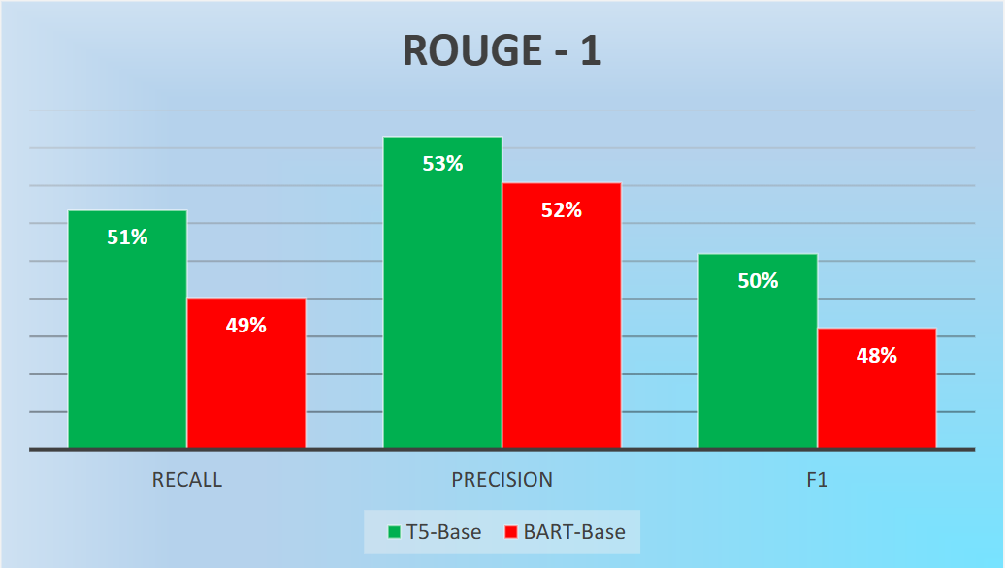

Slide 10
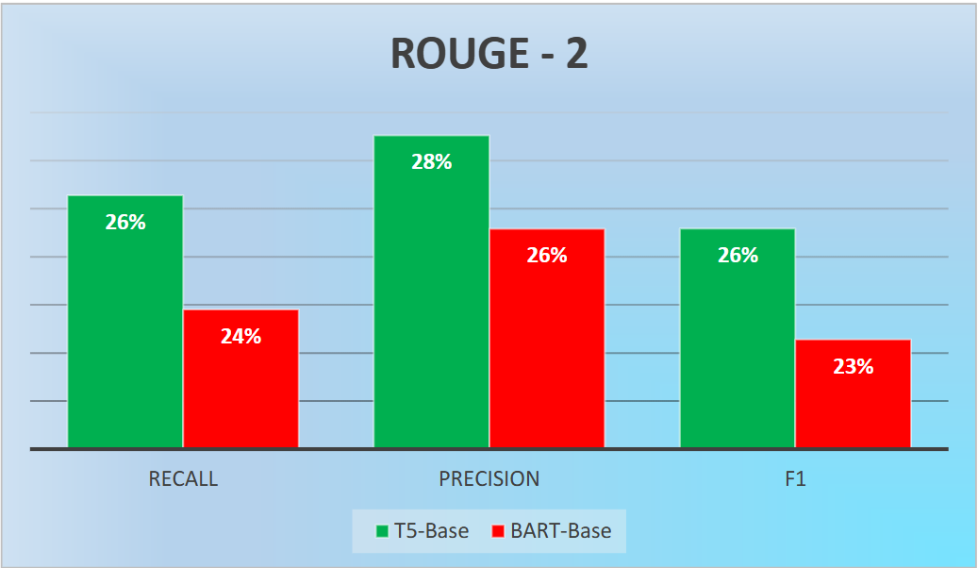

Slide 11
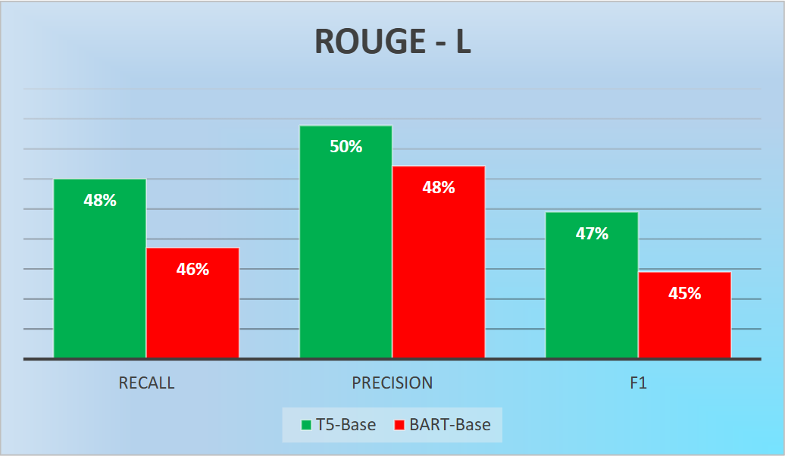

Slide 12
Why T5-Base?
Higher F1 Score: T5-base achieved better F1 Score, outperforming Bart-base, indicating better overall accuracy.
Better Precision and Recall: T5-base showed higher precision and recall, making it more reliable in generating concise and comprehensive summaries.
Efficiency: During evaluation, T5-base demonstrated consistent performance across various test cases, aligning with the project’s objectives.

Slide 13
07. Top Level Architecture

Slide 14
Input - User provides news article URL via streamlit interface.
Tools used - Streamlit
Article Extraction - the newspaper3k library fetches title, author, publish date and full text of the article.
Tools used - Newspaper3k
Text Preprocessing - Clean and preprocess the extracted text to remove unnecessary characters and whitespace.
Tools used - Newspaper3k
Pre-processed text is passed to the fine-tuned T5-base model.
Summarization - model generates an abstractive summary using Tokenization and Beam search for optimal summary generation.
Tools used – Transformers, PyTorch
Output – Display Article metadata Generated summary and Original article (optional, in collapsed view).
Tools used - Streamlit

Slide 15
08. Timeline
Week(s) | Task(s)
Week 1 | Selected project topic and defined objectives.
Week 2 | Conducted research on summarization techniques and related models.
Week 3 | Evaluated and compared pre-trained models (T5-base and Bart-base).
Week 4 | Pre-processed the SAMSUM dataset for fine-tuning.
Week 5 | Fine-tuned the T5-base model with the SAMSUM dataset.
Week 6 | Tested and validated the fine-tuned model with news articles.
Week 7 | Developed a user interface using Streamlit for summarization.
Week 8 | Integrated the model and user interface into a complete application.
Week 9 | Conducted performance evaluation and refined the model.
Week 10 | Prepared the final presentation slides and demo.
Week 11 | Prepared documentation and report of the project.

Slide 16
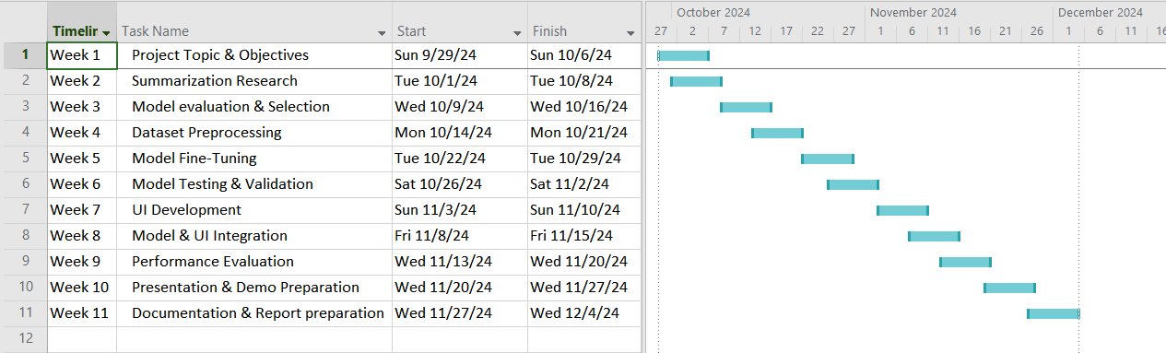
GHANTT CHART

Slide 17
09. Demonstration

Slide 18
10. Challenges
Limited Computational Resources: Faced challenges in handling larger models due to hardware constraints, leading to the selection of smaller, more efficient models like T5-base.
Dataset Compatibility: Pre-trained models like T5-base and Bart-base were not originally trained on the SAMSUM dataset, requiring extensive fine-tuning to achieve desired performance.
Error Handling in Article Summarization: Issues in handling poorly formatted or incomplete articles fetched from URLs caused interruptions in the summarization process.

Slide 19
11. Lessons Learned
Model Selection and Fine-tuning: Gained insights into the importance of evaluating multiple models and selecting the one best suited for the project’s objectives.
Efficient Use of Resources: Learned to optimize computational resources by selecting smaller models without compromising performance.
Error Management and Debugging: Improved skills in identifying and resolving errors during model implementation and article summarization.

Slide 20
12. Future Direction
Expand to Larger Models: Explore and fine-tune larger pre-trained models like T5-large or Pegasus for potentially better summarization quality.
Support for Multiple Languages: Extend the system to summarize articles in different languages using multilingual models.
Enhanced Dataset Utilization: Incorporate larger and more diverse datasets to improve the model's generalization across various news domains.

Slide 21
13. Conclusion
Successfully developed an automated news article summarization system using a fine-tuned T5-base model.
The project highlights the effectiveness of abstractive summarization in generating concise, human-like summaries.
Demonstrated the practical application of NLP techniques in real-world scenarios.
Overcame challenges such as limited computational resources and dataset compatibility to deliver a functional solution.

Slide 22
12. References
Zhang, H., Xu, J. and Wang, J. (2019). Pretraining-Based Natural Language Generation for Text Summarization. [online] arXiv.org. Available at: https://doi.org/10.48550/arXiv.1902.09243 [Accessed 10 Dec. 2024].
Cheng, J. and Lapata, M. (2016). Neural Summarization by Extracting Sentences and Words. [online] ACLWeb. doi:https://doi.org/10.18653/v1/P16-1046.
Nenkova, A. (2011). Automatic Summarization. Foundations and Trends® in Information Retrieval, 5(2), pp.103–233. doi:https://doi.org/10.1561/1500000015.
Liu, Y. and Lapata, M. (2019). Text Summarization with Pretrained Encoders. [online] arXiv.org. Available at: https://doi.org/10.48550/arXiv.1908.08345 [Accessed 10 Dec. 2024].

Slide 23
Thanks!
Do you have any questions?

